Slide 1


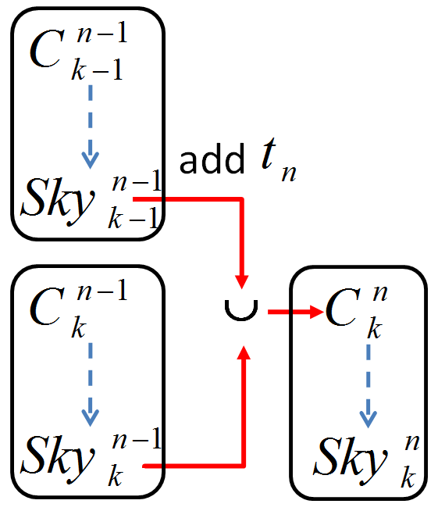
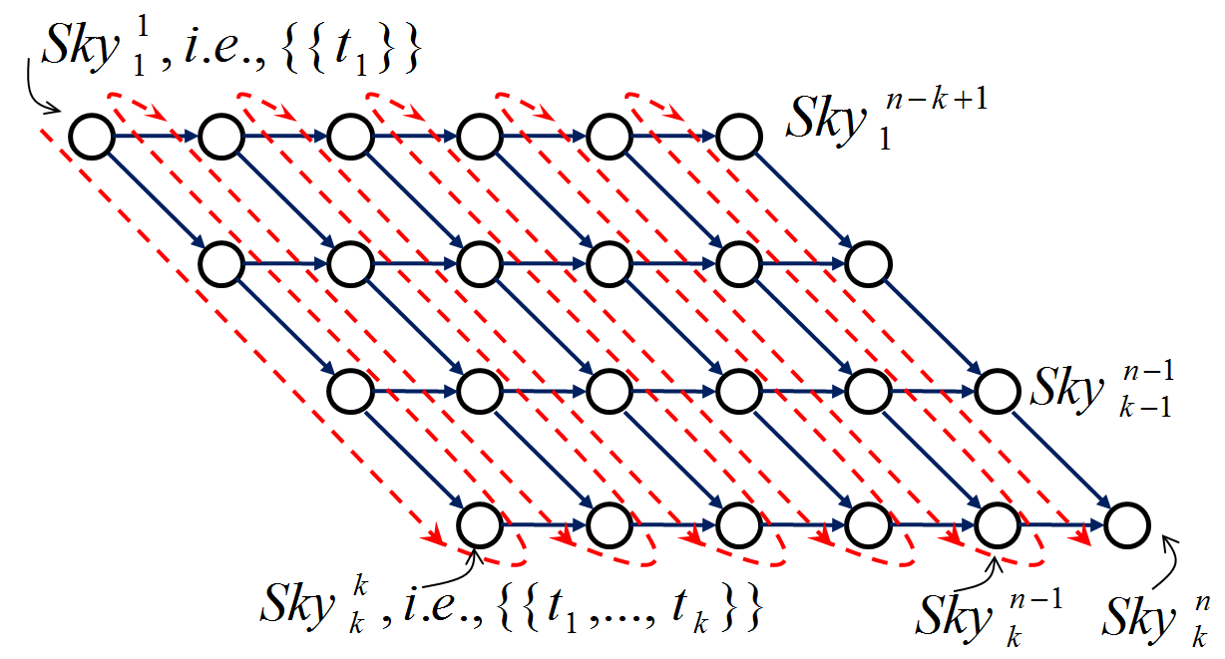
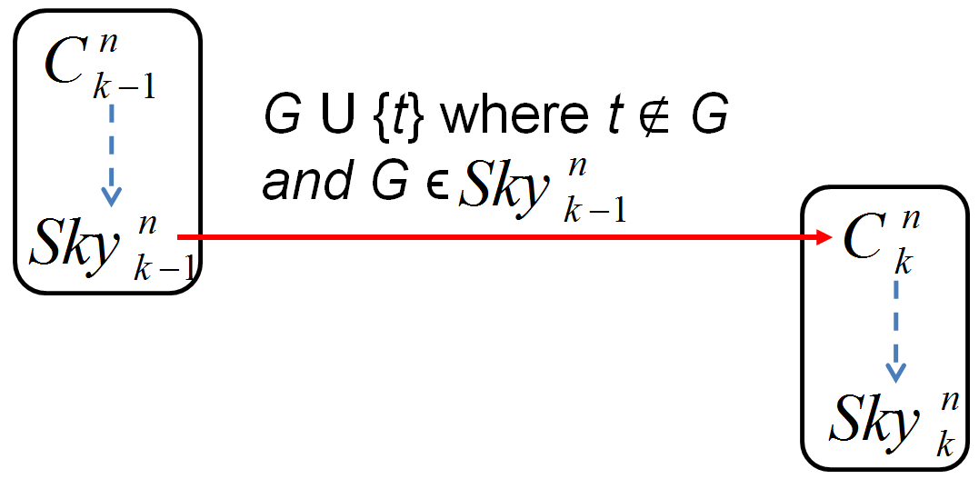
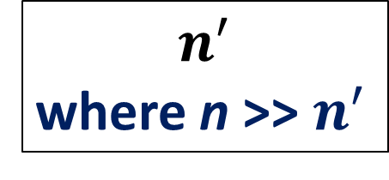
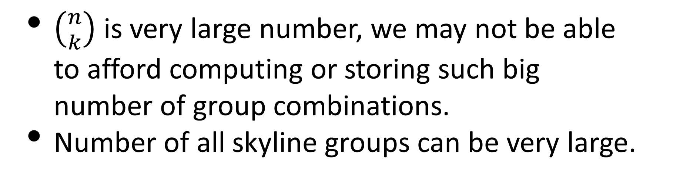
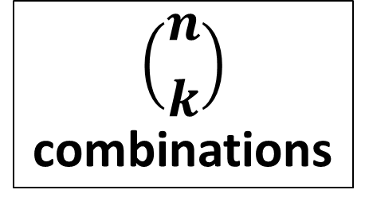
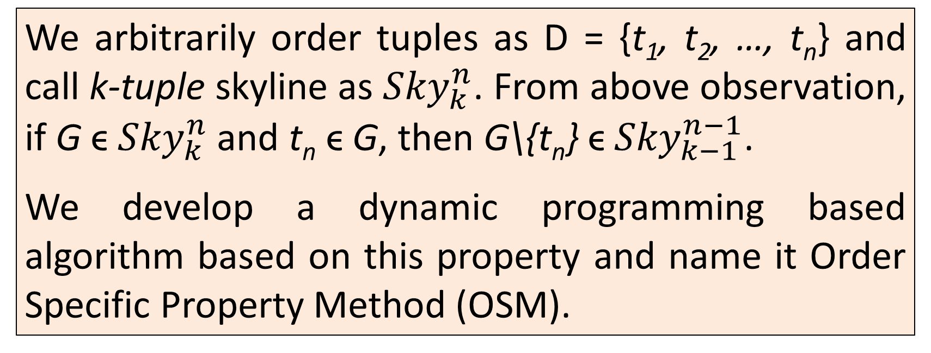
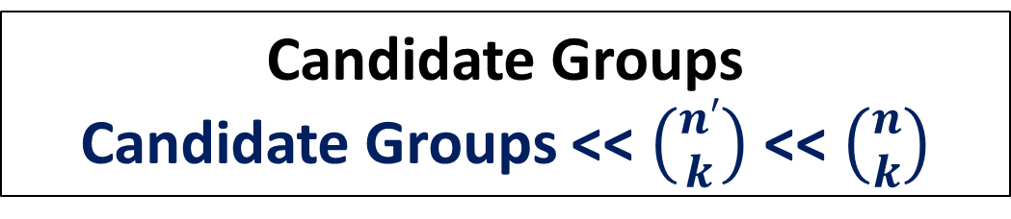
On Skyline Groups
Chengkai Li¹, Nan Zhang², Naeemul Hassan¹, Sundaresan Rajasekaran², Gautam Das^{1, 3}
¹University of Texas at Arlington, ²George Washington University, ³Qatar Computing Research Institute
MOTIVATION
SYSTEM FRAMEWORK
POST PROCESSING
Find a group of experts
Form a team in online fantasy games
Perform a task in developing software
Group of reviewer for paper review
Find a group of objects
Buying shares from Stock Market.
Baseline
Our Framework
This step is necessary for finding all skyline groups from unique skyline vectors
MIN: It is sufficient to find all input tuples which are equal to or dominate a skyline vector and then find k-tuple combination of these; time complexity O(n).
MAX: The problem is NP-hard. But simple brute-force is practically efficient because of small input size.
n tuples
Group size k
Group Enumeration
SUM/ MIN/ MAX
$$\left({n \atop k}\right)$$
combinations
n tuples
Group size k
Input
Pruning
$$n^{′}$$
where n >> $n^{′}$
Skyline Operation
Search Space Pruning
(OSM/WCM)
Challenges
All Skyline Groups
Candidate Groups
Candidate Groups << $\left({n′ \atop k}\right)$ << $\left({n \atop k}\right)$
SKYLINE GROUP
$\left({n \atop k}\right)$ is very large number, we may not be able
to afford computing or storing such big
number of group combinations.
Number of all skyline groups can be very large.
Skyline Operation
Output Pruning
 | Points | Assists | Blocks
P₁ | 3 | 4 | 5
P₂ | 4 | 2 | 3
P₃ | 4 | 5 | 3
P₄ | 2 | 1 | 2
P₅ | 4 | 1 | 2
D = {P₁, P₂, P₃, P₄, P₅}
All Skyline Groups
Post
Processing
Unique Skyline Vectors
Find skyline groups of 3 players
EXPERIMENTS
SEARCH SPACE PRUNING: OSM
SEARCH SPACE PRUNING: WCM
NBA Players Score
MAX
Points | Assists | Blocks
4 | 5 | 5
4 | 4 | 5
4 | 4 | 5
4 | 5 | 5
4 | 5 | 5
4 | 4 | 5
4 | 5 | 3
4 | 5 | 3
4 | 2 | 3
4 | 5 | 3
P₂, P₃, P₅
a 3-tuple skyline of D.
For MIN and MAX, if G ϵ Sky(D,k), then at least one (k-1)-tuple subset of G will be a (k-1)-tuple skyline. This is weaker than Apriori property; such called Weak Candidate Generation Property Method (WCM).
This is only valid when distinct value property holds. However, our algorithm extends this to general cases.
 | SUM
 | Points | Assists | Blocks
P₁, P₂, P₃ | 11 | 11 | 11
P₁, P₂, P₄ | 9 | 7 | 10
P₁, P₂, P₅ | 11 | 7 | 10
P₁, P₃, P₄ | 9 | 10 | 10
P₁, P₃, P₅ | 11 | 10 | 10
P₁, P₄, P₅ | 9 | 6 | 9
P₂, P₃, P₄ | 10 | 8 | 8
P₂, P₃, P₅ | 12 | 8 | 8
P₂, P₄, P₅ | 10 | 4 | 7
P₃, P₄, P₅ | 10 | 7 | 7
MIN
Points | Assists | Blocks
3 | 2 | 3
2 | 1 | 2
3 | 1 | 2
2 | 1 | 2
3 | 1 | 2
2 | 1 | 2
2 | 1 | 2
4 | 1 | 2
2 | 1 | 2
2 | 1 | 2
P₂, P₃
a 2-tuple skyline of D – {P₅}.
P₂
a 1-tuple skyline of D – {P₃, P₅}.
We arbitrarily order tuples as D = {t₁, t₂, …, t_{n}} and call k-tuple skyline as ${Sky}_{k}^{n}$. From above observation, if G ϵ ${Sky}_{k}^{n}$ and t_{n} ϵ G, then G\{t_{n}} ϵ ${Sky}_{k−1}^{n−1}$.
We develop a dynamic programming based algorithm based on this property and name it Order Specific Property Method (OSM).
Execution time comparison of Baseline and OSM for SUM function. Time in seconds, logarithmic scale.
PROBLEM
Given a database table D of n tuples {t₁, t₂, …, t_{n}} and m attributes A₁, A₂, …, A_{m}, a subset of k tuples i.e. G : {t_{i1}, …, t_{ik}} is a k-tuple group.
The problem is to find the skyline of k-tuple groups of D i.e. Sky(D, k).
The groups are compared by their aggregates.
We consider Summation (SUM), Minimum (MIN) and Maximum (MAX) as aggregate functions.
Number of generated candidate groups comparison of Baseline and OSM for SUM function. Logarithmic scale.
This property is satisfied by SUM and also can be extended for MIN and MAX.
WCM is satisfied by MIN and MAX. SUM does not satisfy this property.
Data Set
NBA players performance statistics (points, assists, rebounds, steals and blocks per game) in 2009 regular season.
Synthetic Dataset of 10 Million records of 5 attributes.
OUTPUT PRUNING
INPUT PRUNING
Multiple groups with the same score.
Observed in MAX and MIN but rare in SUM.
Find unique skyline vectors instead of all skyline groups.
For instance,
{P₁, P₂, P₃}, {P₁, P₃, P₄} and {P₁, P₃, P₅} are all skyline groups for MAX function having same unique skyline vector [4, 5, 5].
If a tuple is dominated by >= k tuples, it can be discarded for unique skyline vector calculation.
 | Points | Assists | Blocks
P₁ | 3 | 4 | 5
P₂ | 4 | 2 | 3
P₃ | 4 | 5 | 3
P₄ | 2 | 1 | 2
P₅ | 4 | 1 | 2
k-1 tuple
t
k-1 tuple
t’
REFERENCES
G
G’ dominates G
G
[1] C. Li, N. Zhang, N. Hassan, S. Rajasekaran, and G. Das. On Skyline Groups. In CIKM 2012.
Input pruning significantly reduces size of n.

